Slide 1
Developing effective career-technical education partnerships
Kim Graves – Job Placement Coordinator kim.graves@pickawaryross.com –740-642-1217
Allen Koker – Job Placement Coordinator – allen.koker@pickawayross.com – 740-642-1361
Pickaway-Ross Career and Technology Center

Slide 2
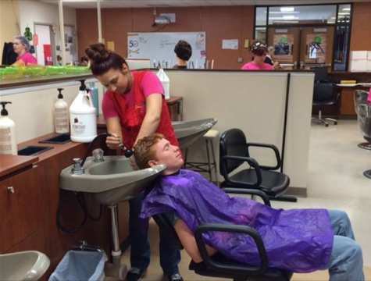
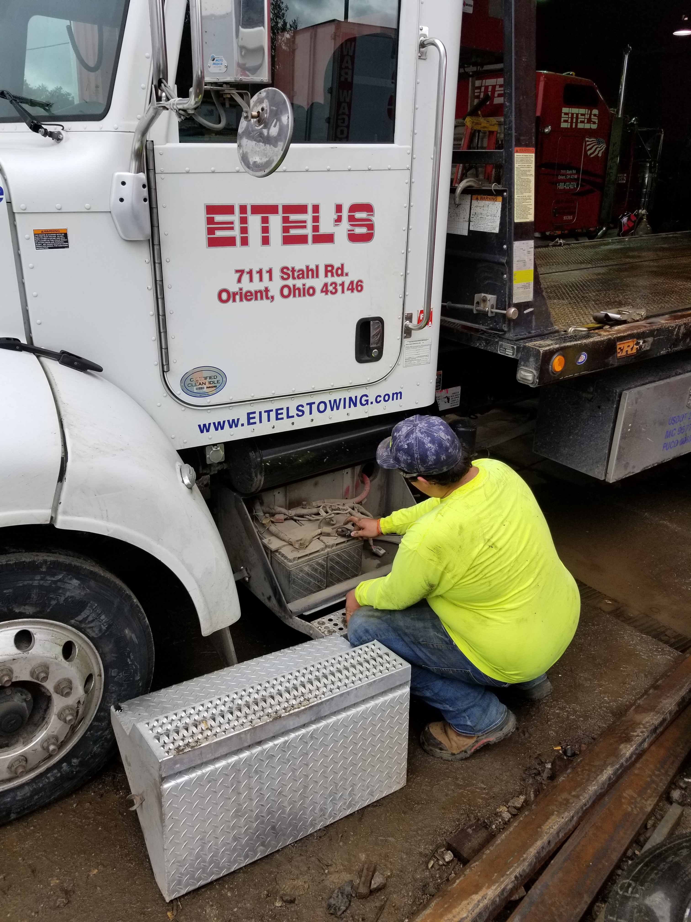
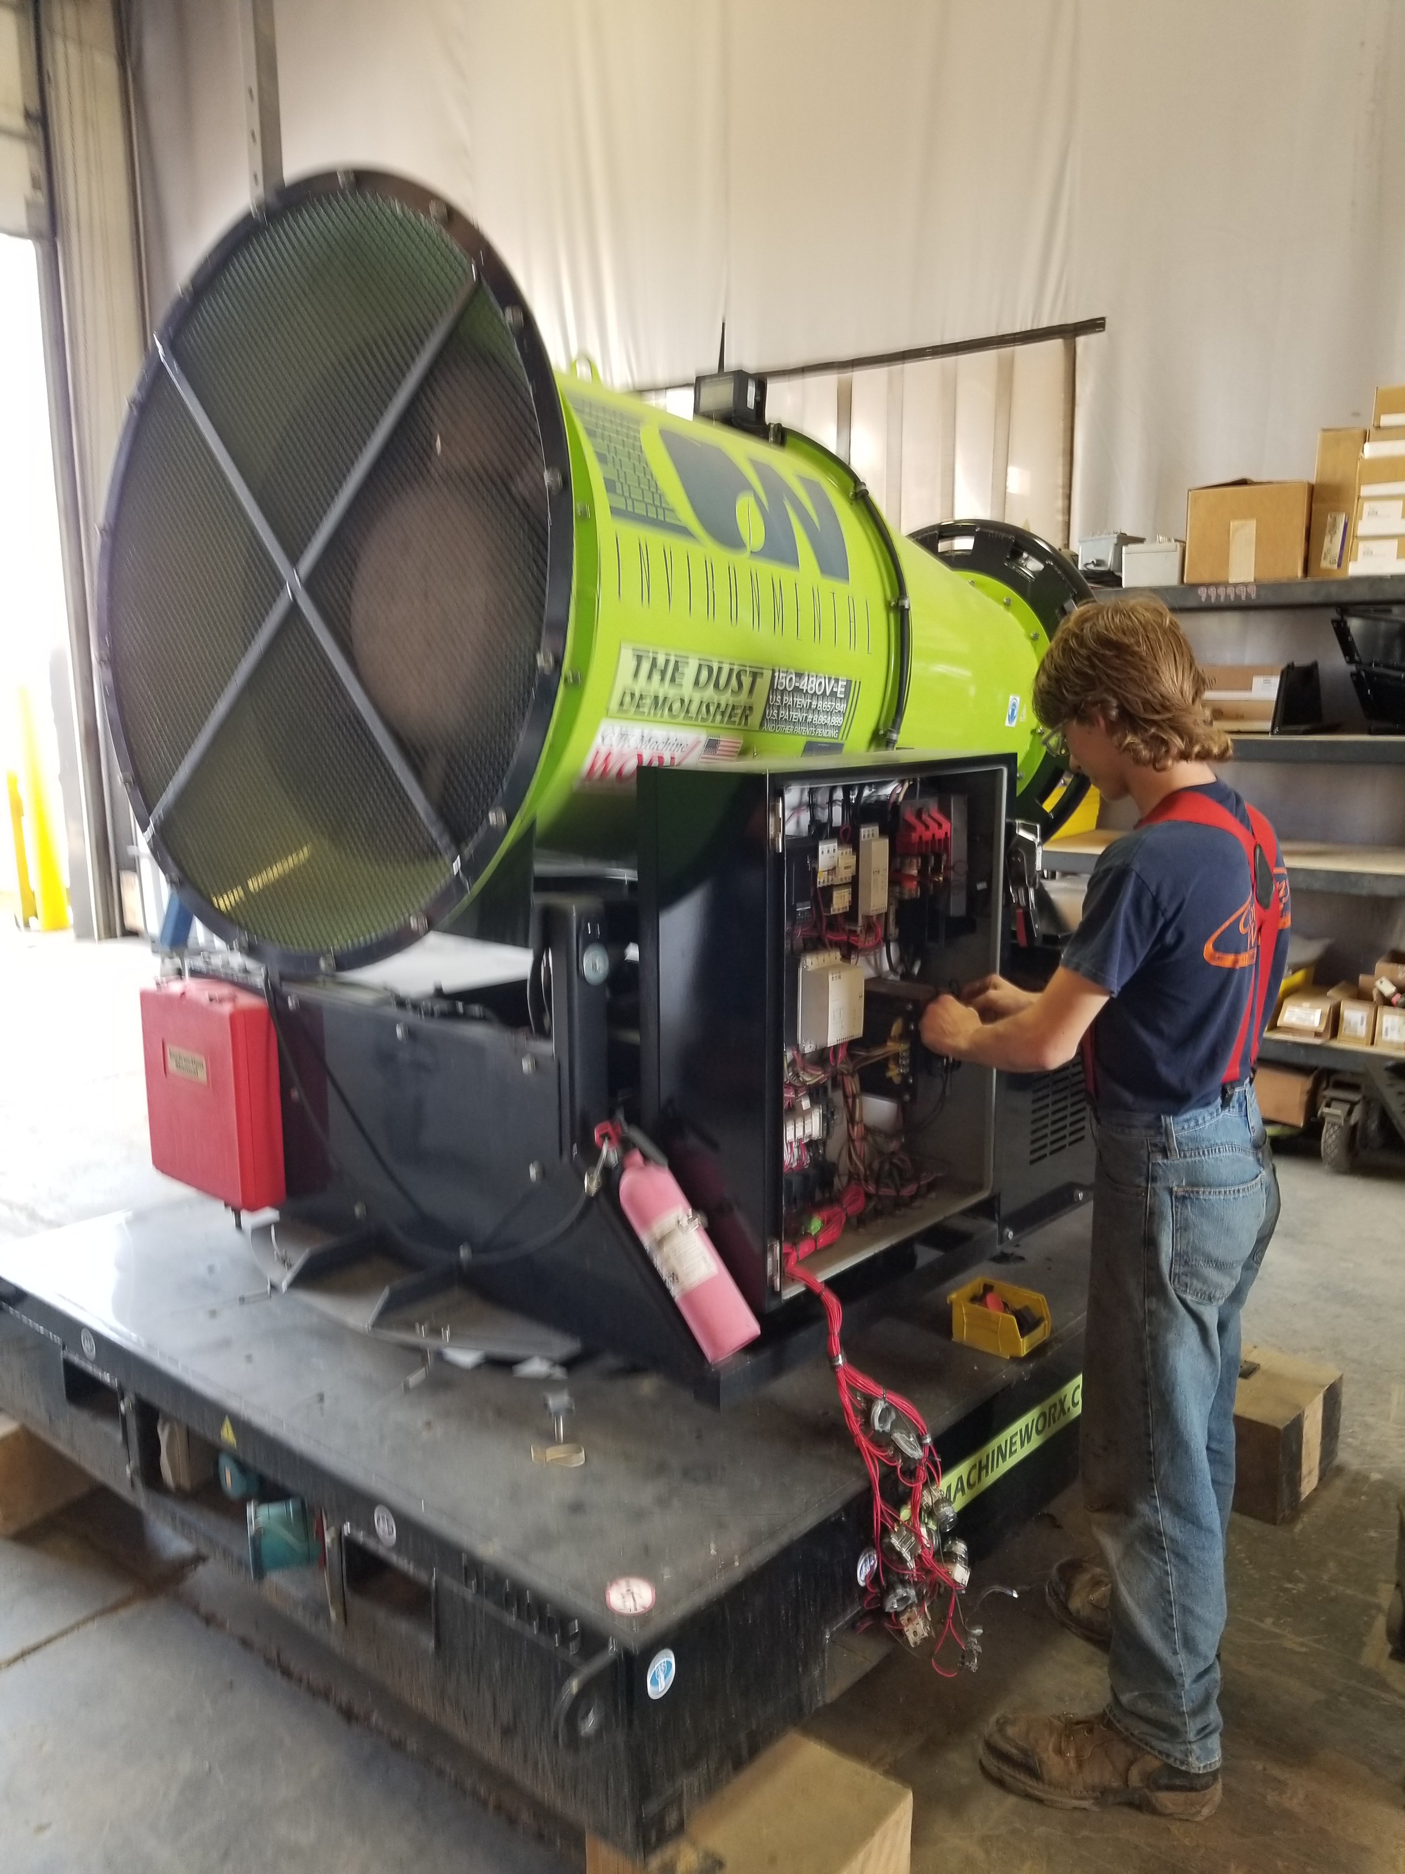
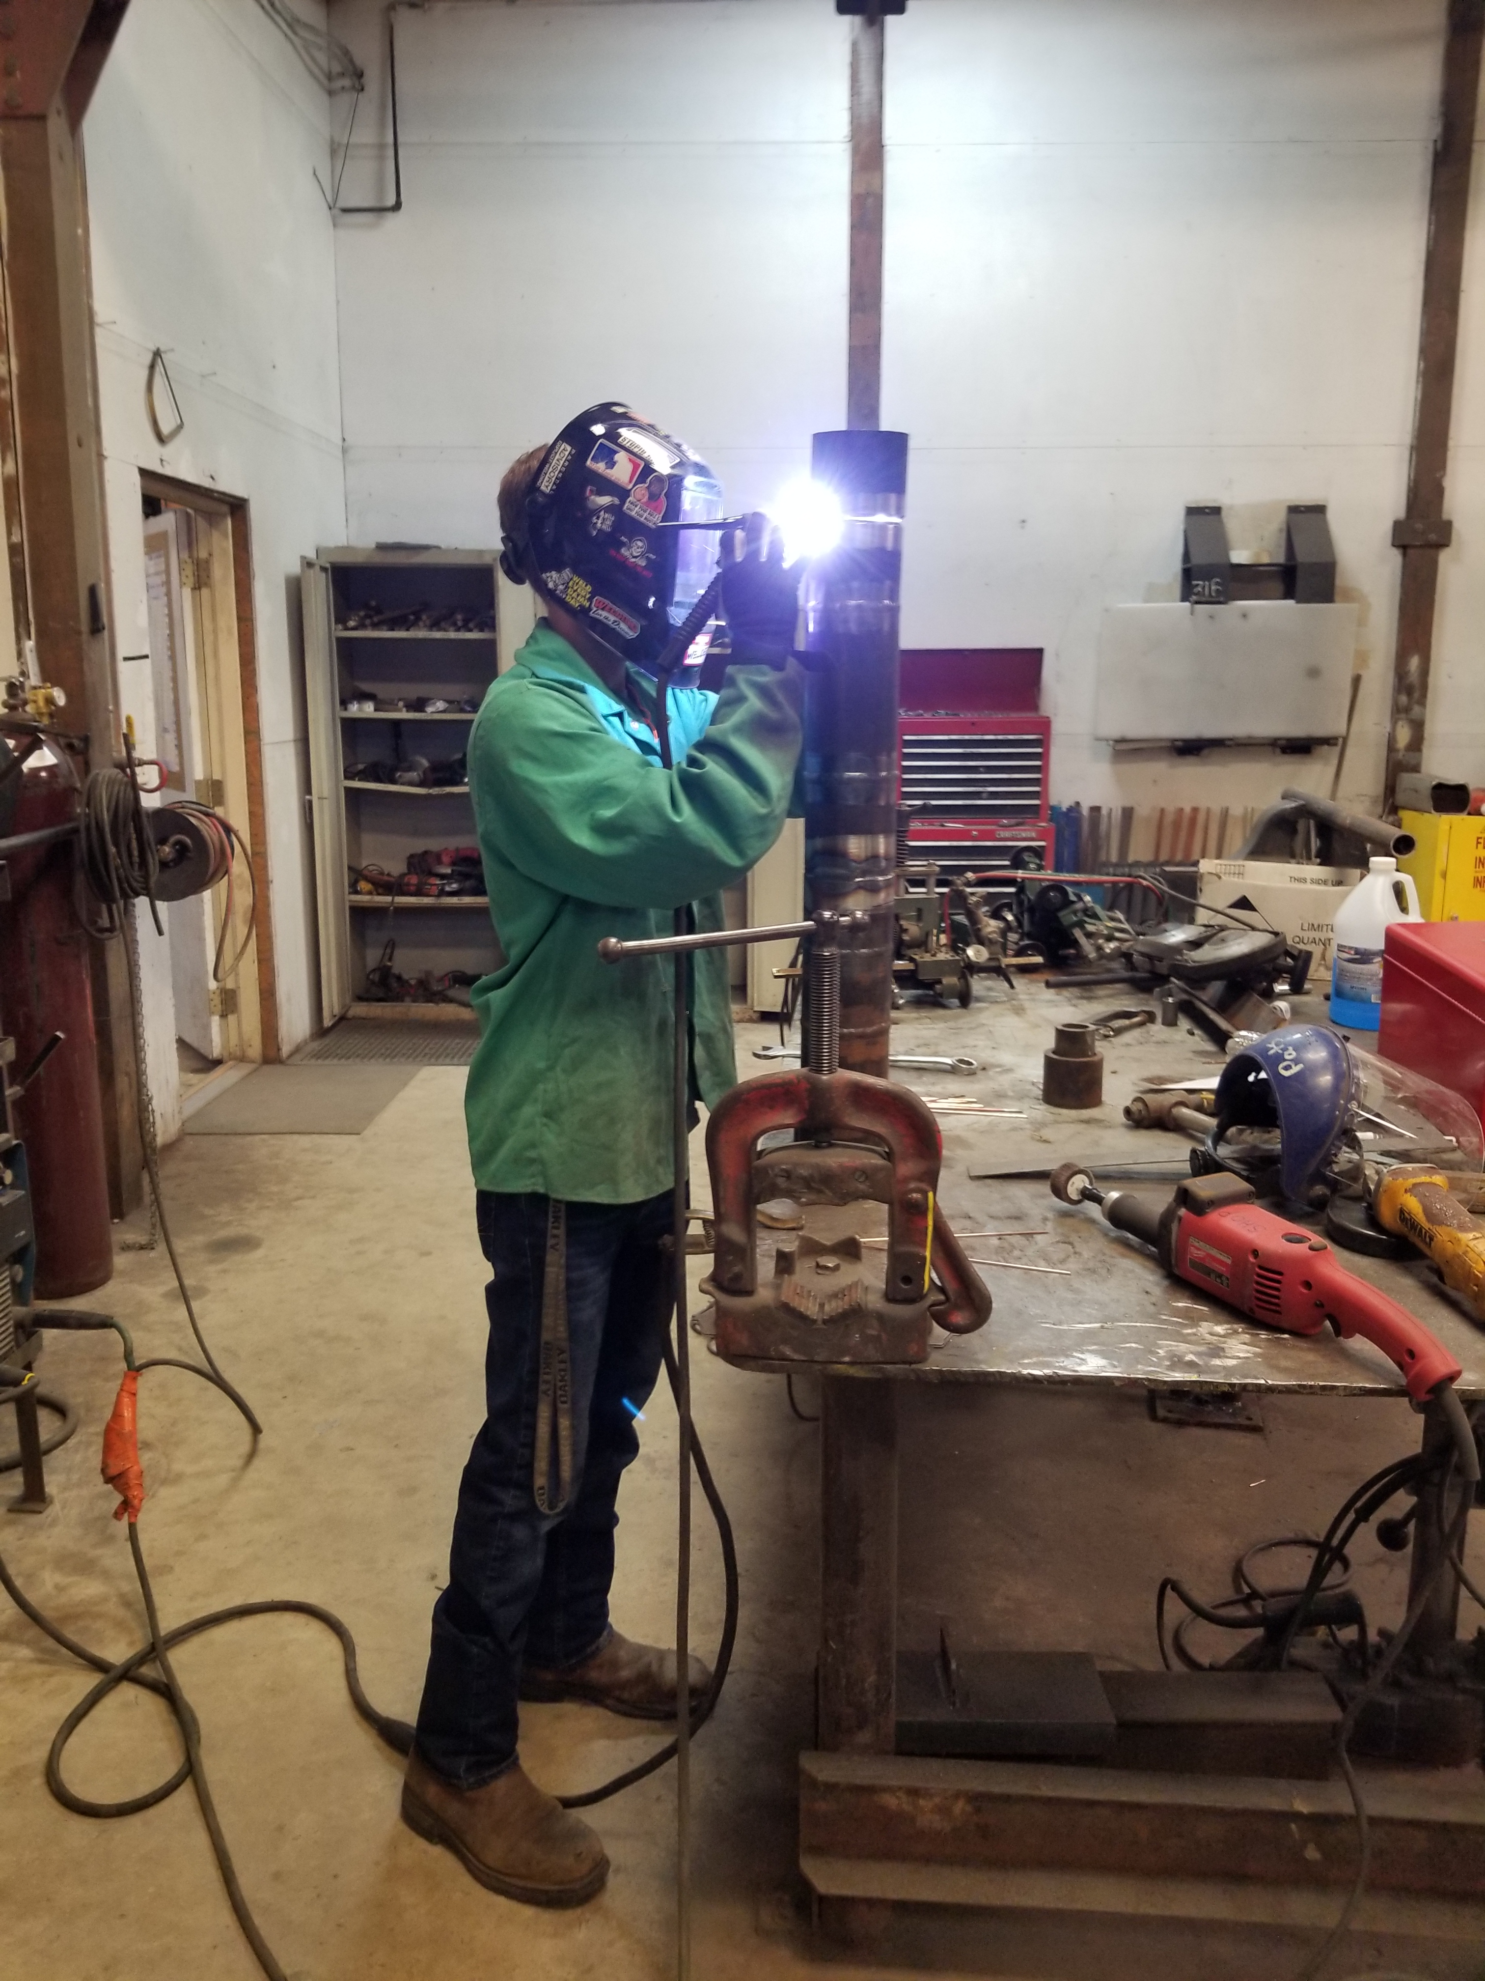
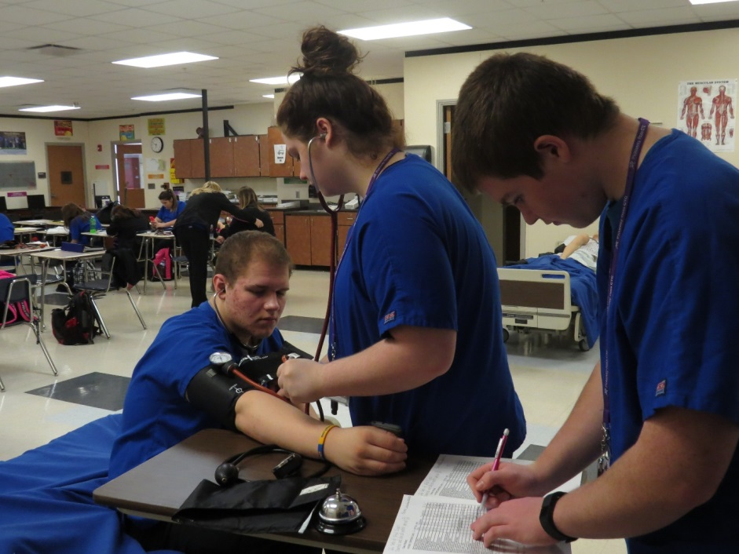
EMPLOYMENT TRENDS

Slide 3
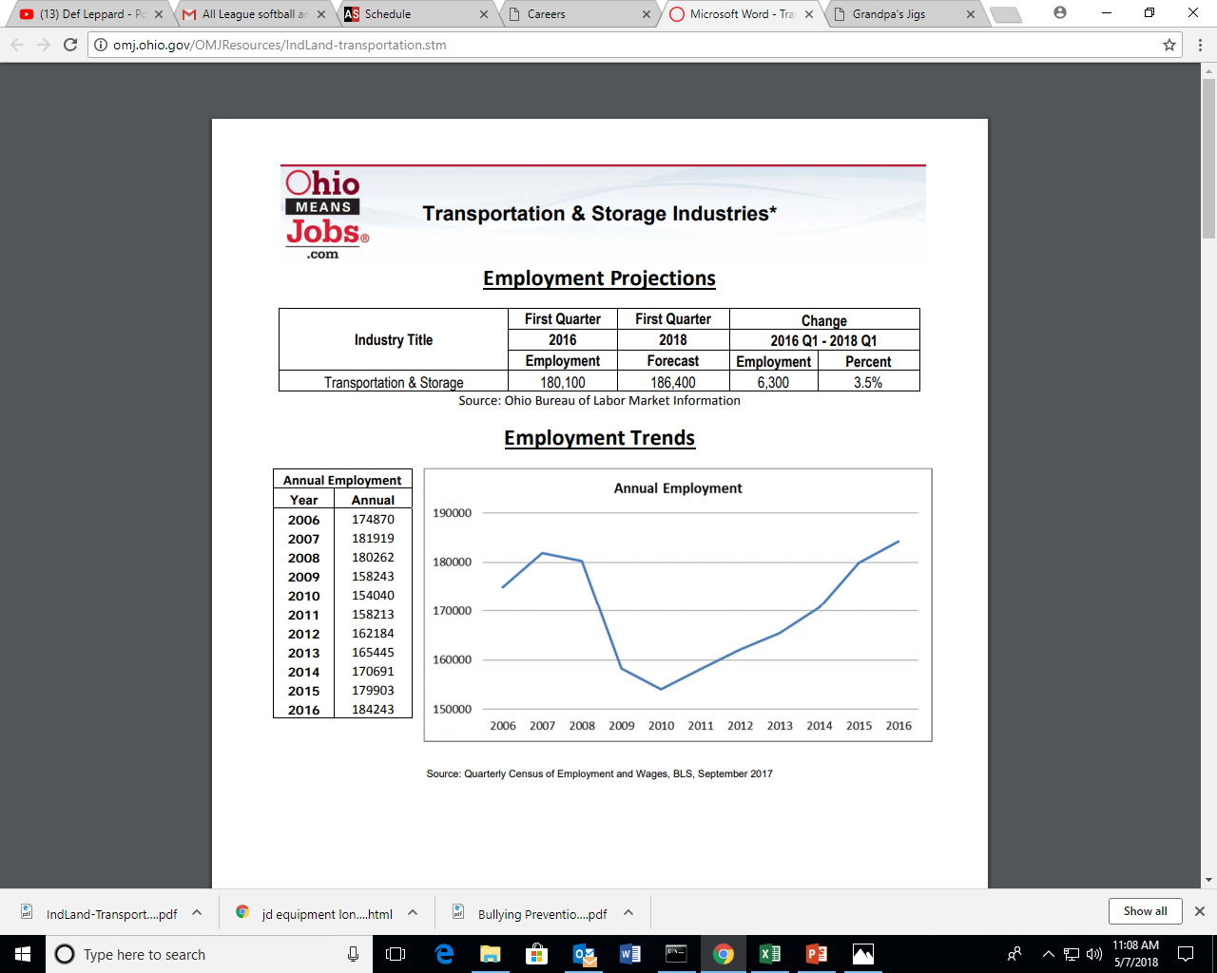
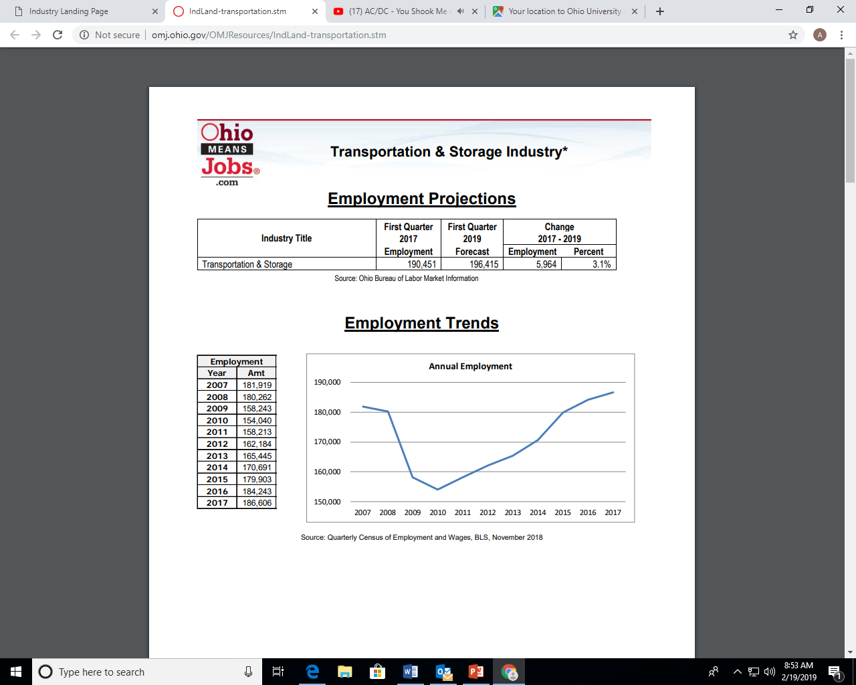

Slide 4
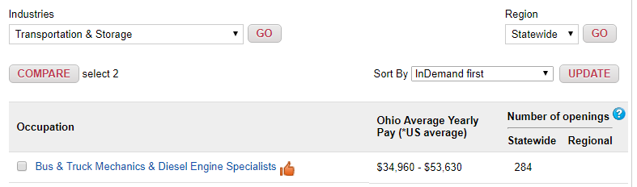
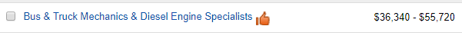
2018-2019

Slide 5
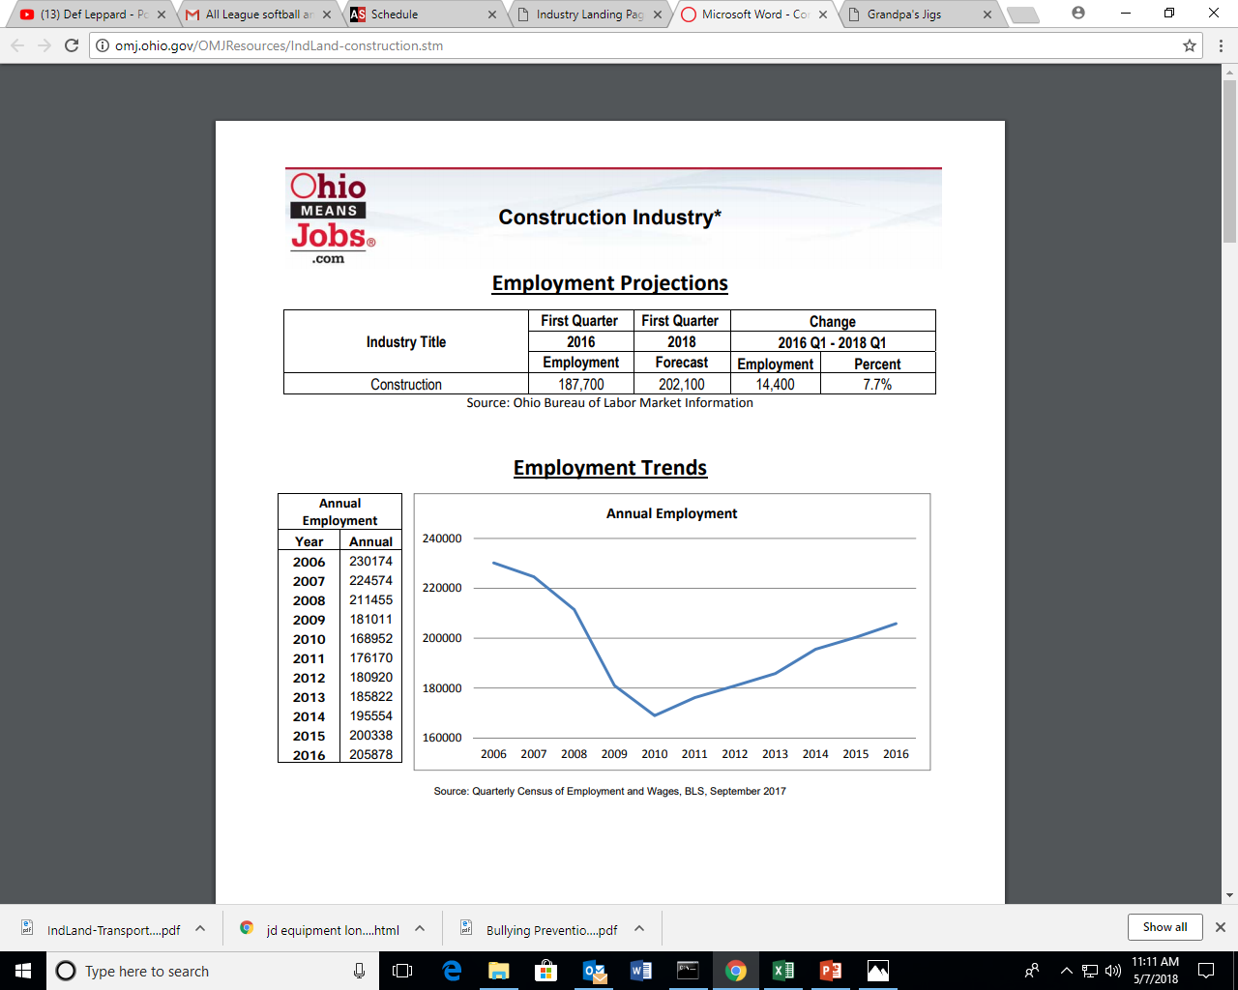

Slide 6
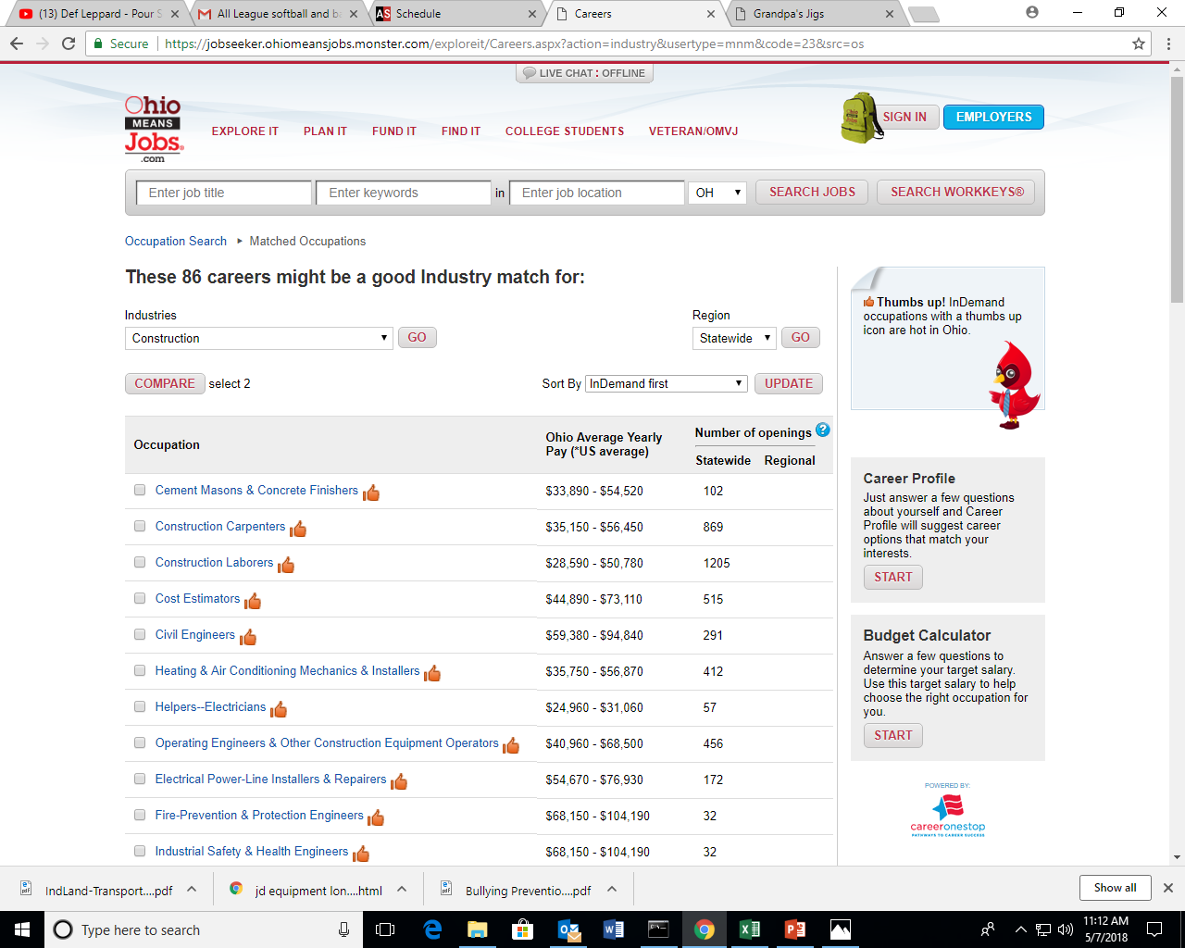
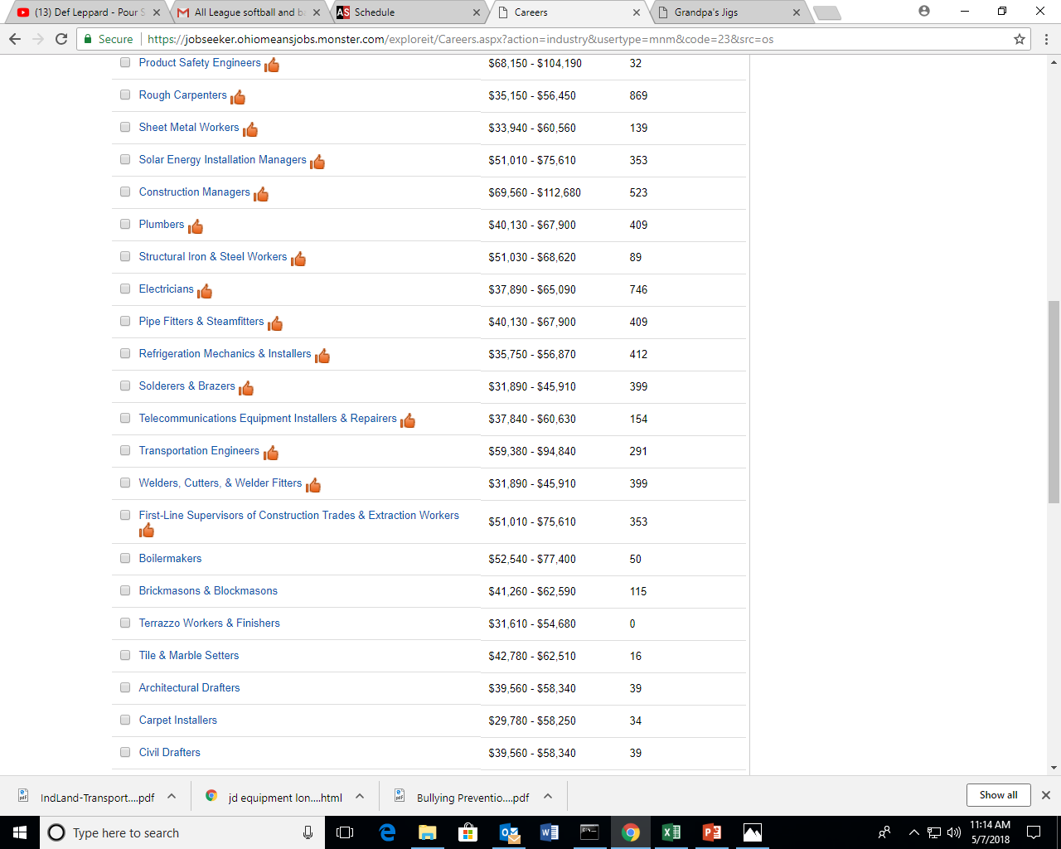

Slide 7
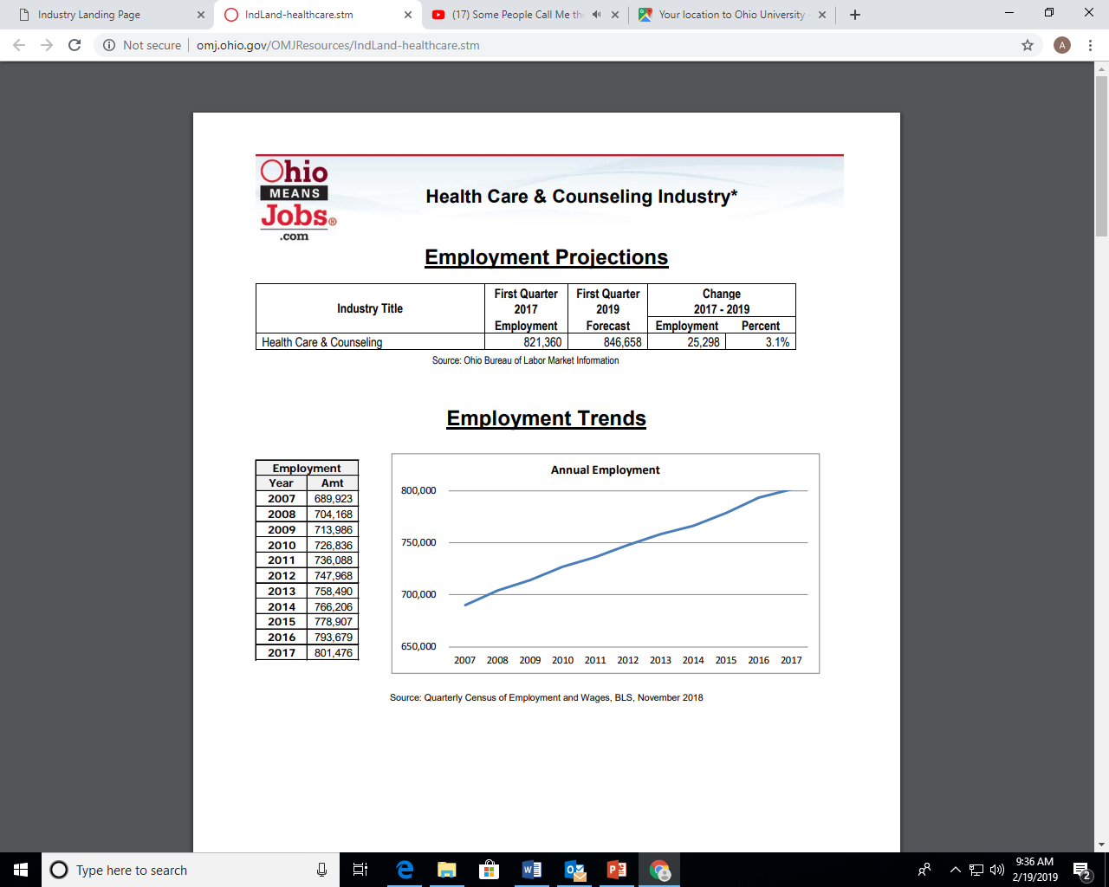

Slide 8
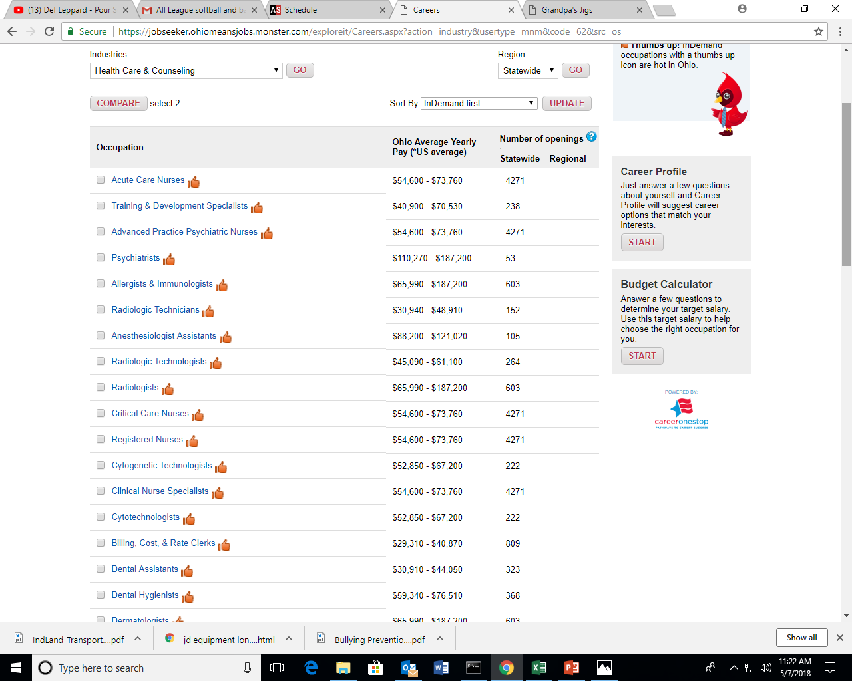
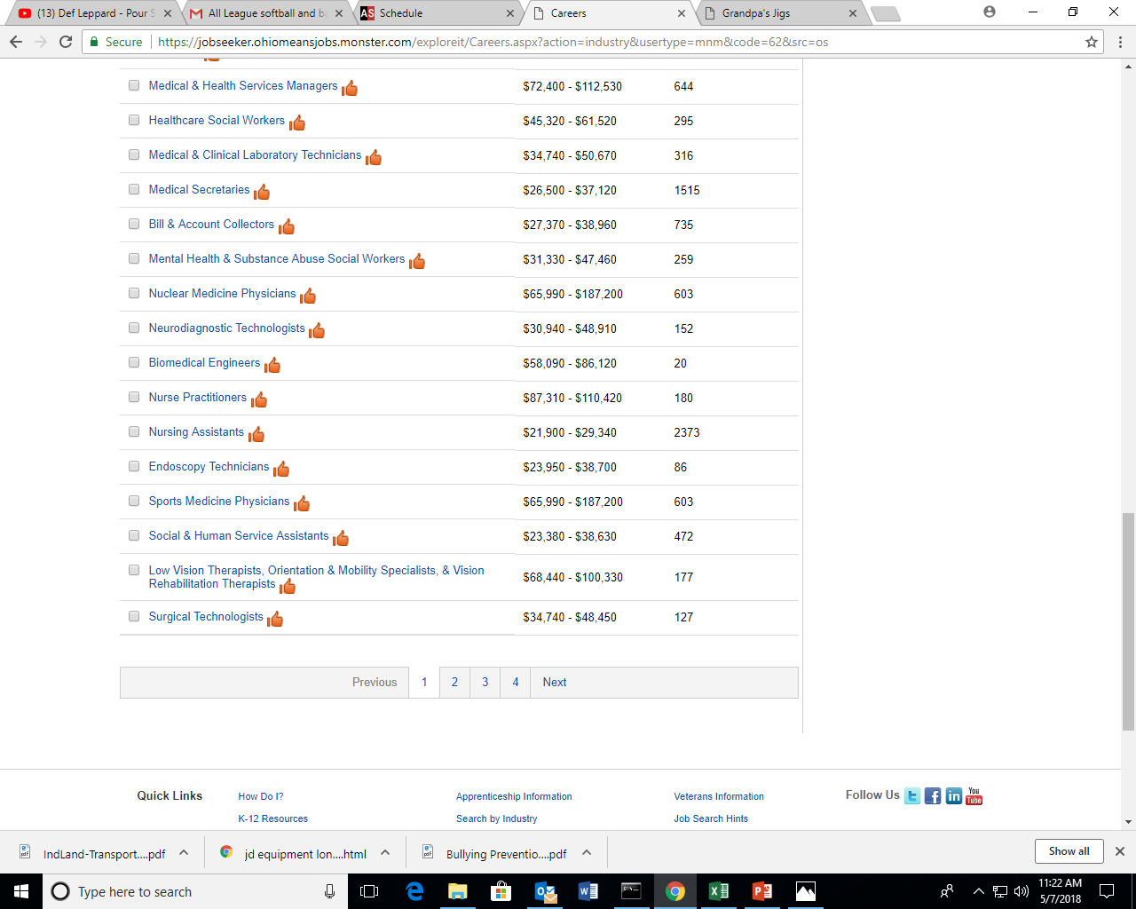

Slide 9
Types of Partnerships
Guidance Counselors
Advisory Board Members
Resource Partners – Employment Agencies
Employers

Slide 10
Guidance Counselors
Meeting Graduation Requirements
Half-Day Placement
Full Placement
Week on Week off
Flexible Scheduling (PLATO)

Slide 11
Pre-Apprenticeship/Apprenticeship
Denier Electric
IBEW
Corna Kokosing
Company Wrench
JD Equipment
Lithko
Superior Die & Tool
Suburban Metal
TOSOH
MHC Kenworth
Rural King
Clearcreek Construction

Slide 12
Pre-Apprenticeship/Apprenticeship
Heartland Nursing
Westmoreland
Signature
Traditions
Wingate
Adena Health System
Logan Elm Health
Valley View
Vallery Ford
Wal-Mart
Lowes
Southeast Machining

Slide 13
Keys to Good Relationships
Meeting Employers Needs in a Timely Manner
Regular Job Site Visits
Background of Students
Providing Quality/Skilled Workers
Showing Appreciation (Banquet/Meals)

Slide 14
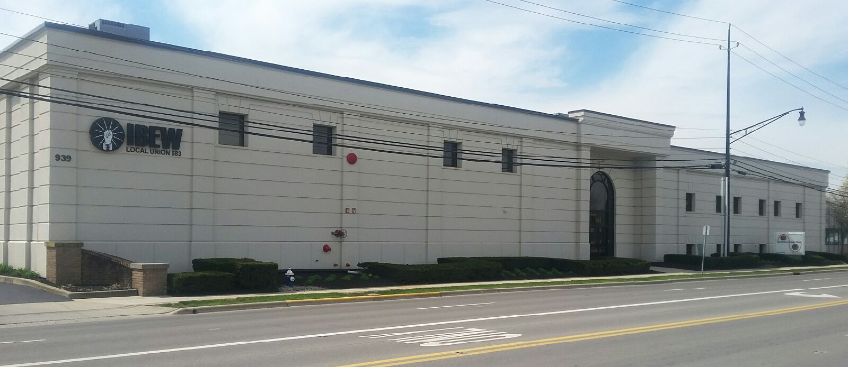
IBEW Local 683

Slide 15
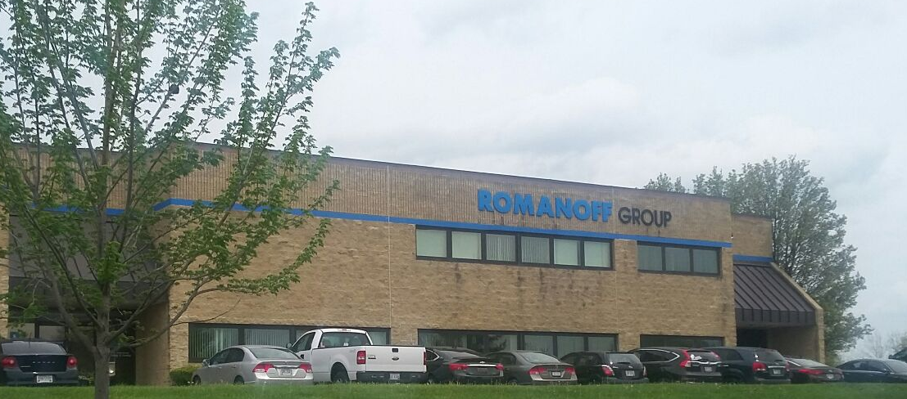
ROMANOFF ELECTRIC

Slide 16
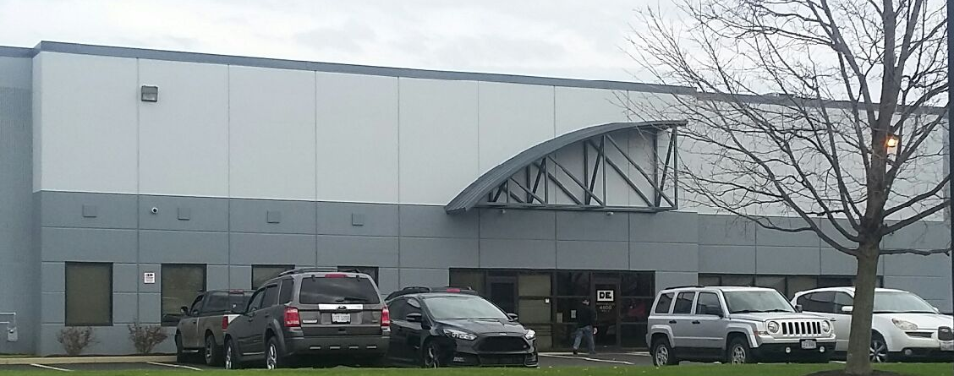
DENIER ELECTRIC

Slide 17
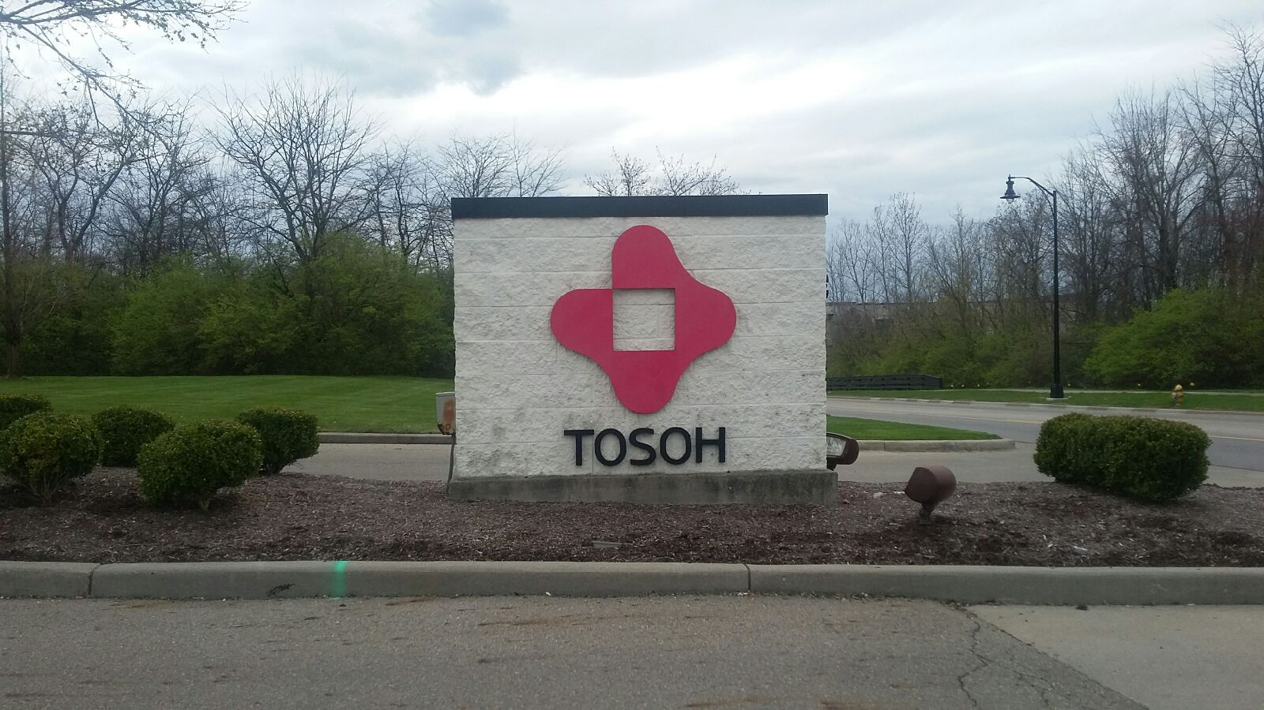
TOSOH MACHINING

Slide 18
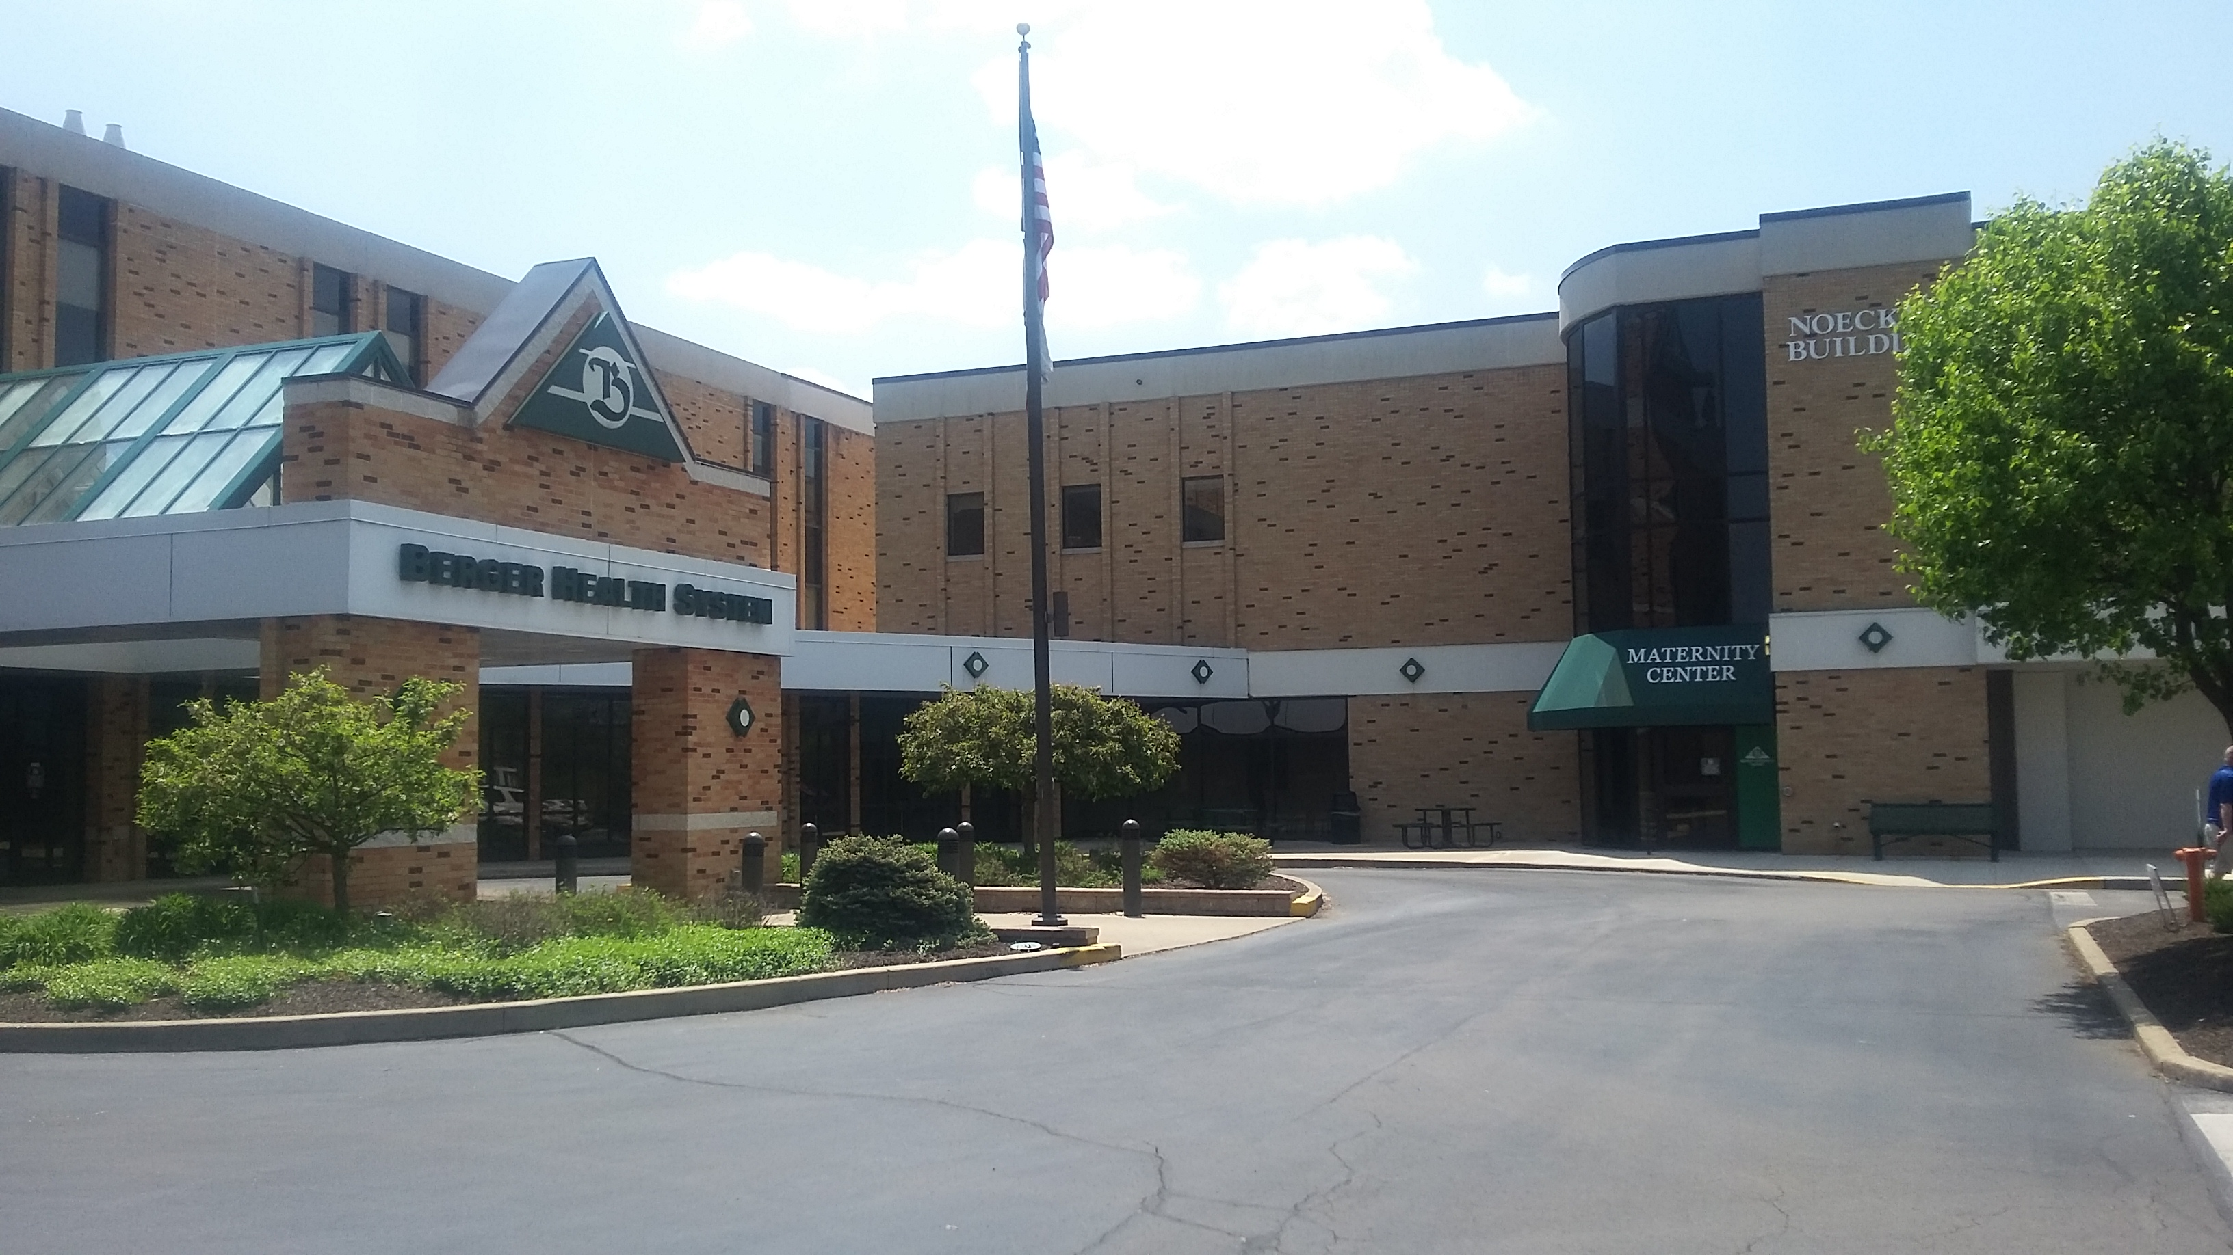
BERGER HEALTH SYSTEM

Slide 19
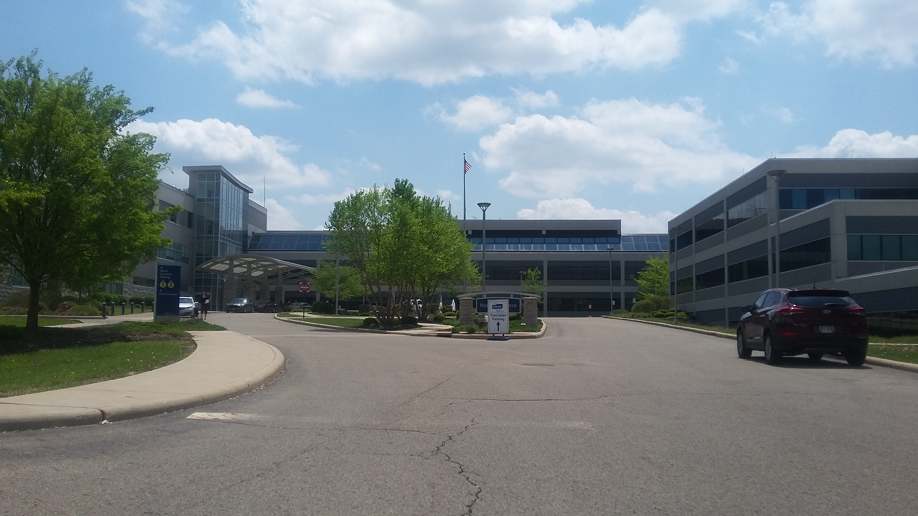
ADENA REGIONAL MEDICAL

Slide 20

THE WYNGATE

Slide 21
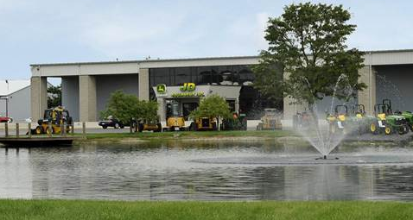
JD EQUIPMENT

Slide 22
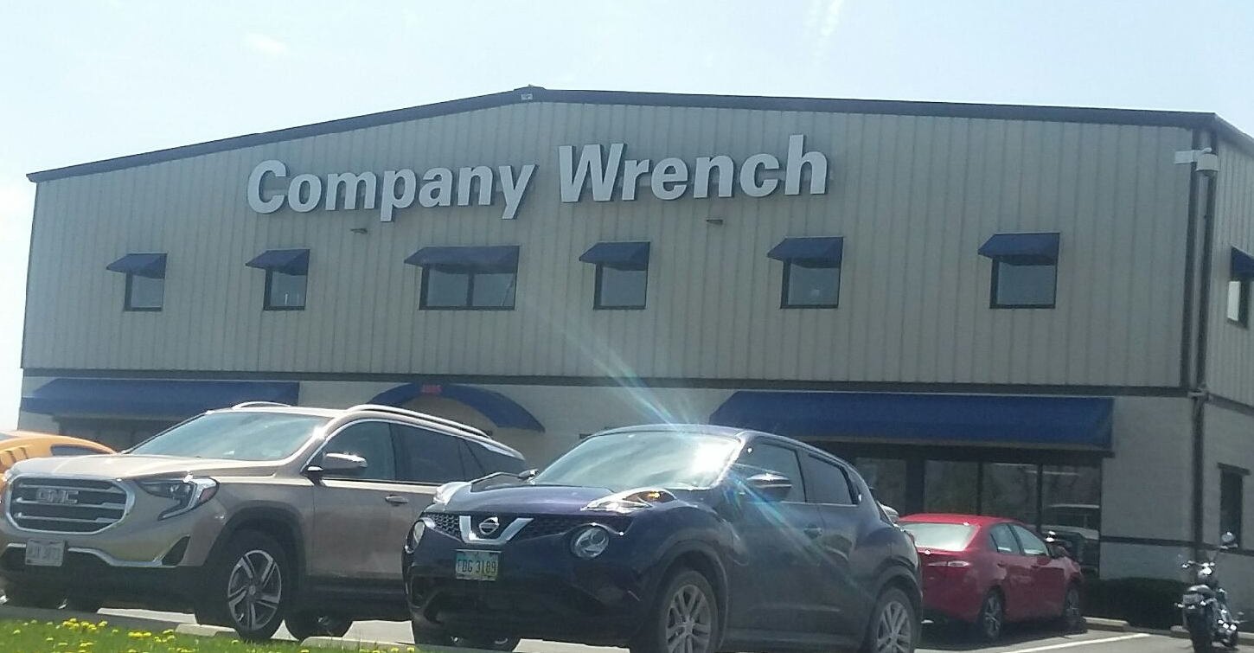
COMPANY WRENCH

Slide 23
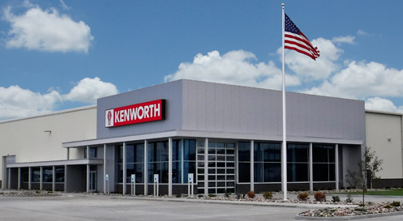
MHC KENWORTH
Road Ready Center

Slide 24
Advisory Council
Assist in Guiding and Directing Curriculum
Approve and Suggest Equipment (Provide)
Speakers in Labs
Tours of Facilities (Possible Employment)
Mock Interviews
Job Fairs by Academy

Slide 25
Resource Partners
Colleges & Universities
Technical Colleges
State Agencies
Military
Adult Education

Slide 26
Questions
Kim Graves – Job Placement Coordinator
Allen Koker – Job Placement Coordinator
Pickaway-Ross Career and Technology Center

